Slide 1
IBM University Engagement Project Submission
“Exploring the Power of Agentic AI with IBM Granite and IBM Bob”

Slide 2

Project Tile – SecureAI Assessment System
Domain of Project – Web Application Security
Student Name | Recent Passport Photo | Email ID | Mobile number [WhatsApp]
Dr. S. Ravi Kumar |  | drravi.saddala@gmail.com | 9866920752

Slide 3
Problem Statement -
Problem Statement : AI-Powered Autonomous Web Application Security Assessment Agent
The Challenge
The proposed system must address several technical and operational challenges:
Detecting Diverse Vulnerabilities
Identify common web application vulnerabilities such as SQL Injection, XSS, CSRF, broken authentication, insecure APIs, and security misconfigurations.
Handling Modern Web Applications
Scan dynamic, JavaScript-based, and Single Page Applications (SPAs) effectively.
Automated Reporting
Produce detailed security assessment reports with vulnerability descriptions, risk levels, and mitigation steps.
Scalability
Support scanning multiple web applications while maintaining performance and reliability.
Security and Privacy
Ensure that scanning activities do not expose sensitive information or negatively impact the target application.
The Objective
Develop an AI-powered autonomous agent for web application security assessment.
Automatically detect common web application vulnerabilities based on the OWASP Top 10.
Analyze and prioritize identified vulnerabilities using risk scoring techniques.
Provide AI-generated remediation recommendations for developers.
Reduce manual effort and improve the speed of security assessments.
Enhance the overall security posture of web applications through continuous monitoring and automated analysis.
Provide an easy-to-use interface for users to initiate scans, monitor progress, and review results.

Slide 4
Proposed Solution -
Proposed Solution: To address the increasing number of web application security threats, this project proposes the development of an AI-Powered Autonomous Web Application Security Assessment Agent. The system will act as an intelligent security assistant that automatically scans web applications, identifies vulnerabilities, evaluates their severity, and provides actionable remediation recommendations with minimal human intervention.
The solution combines Artificial Intelligence (AI), Large Language Models (LLMs), and automated security testing tools to perform end-to-end vulnerability assessment. Users simply provide the URL of the target web application through an interactive interface, and the AI agent manages the complete assessment process.

Slide 5
Technology Used
IBM Bob platform -For designing and orchestrating multi-agent workflows visually
IBM Grainte model - for eg – ibm-granite-3-2-8b – For natural language understanding, reasoning, and personalization
IBM Cloud – It provides the infrastructure to build, deploy, and scale the Nutrition Agent efficiently. IBM Cloud enables a reliable, secure, and scalable environment for deploying the Nutrition Agent.

Slide 6
Required Files created using IBM bob -
1 | server.js
2 | start-server.ps1
3 | public/index.html
4 | index.html
5 | package.json
6 | manifest.yml
7 | Procfile
8 | .cfignore

Slide 7
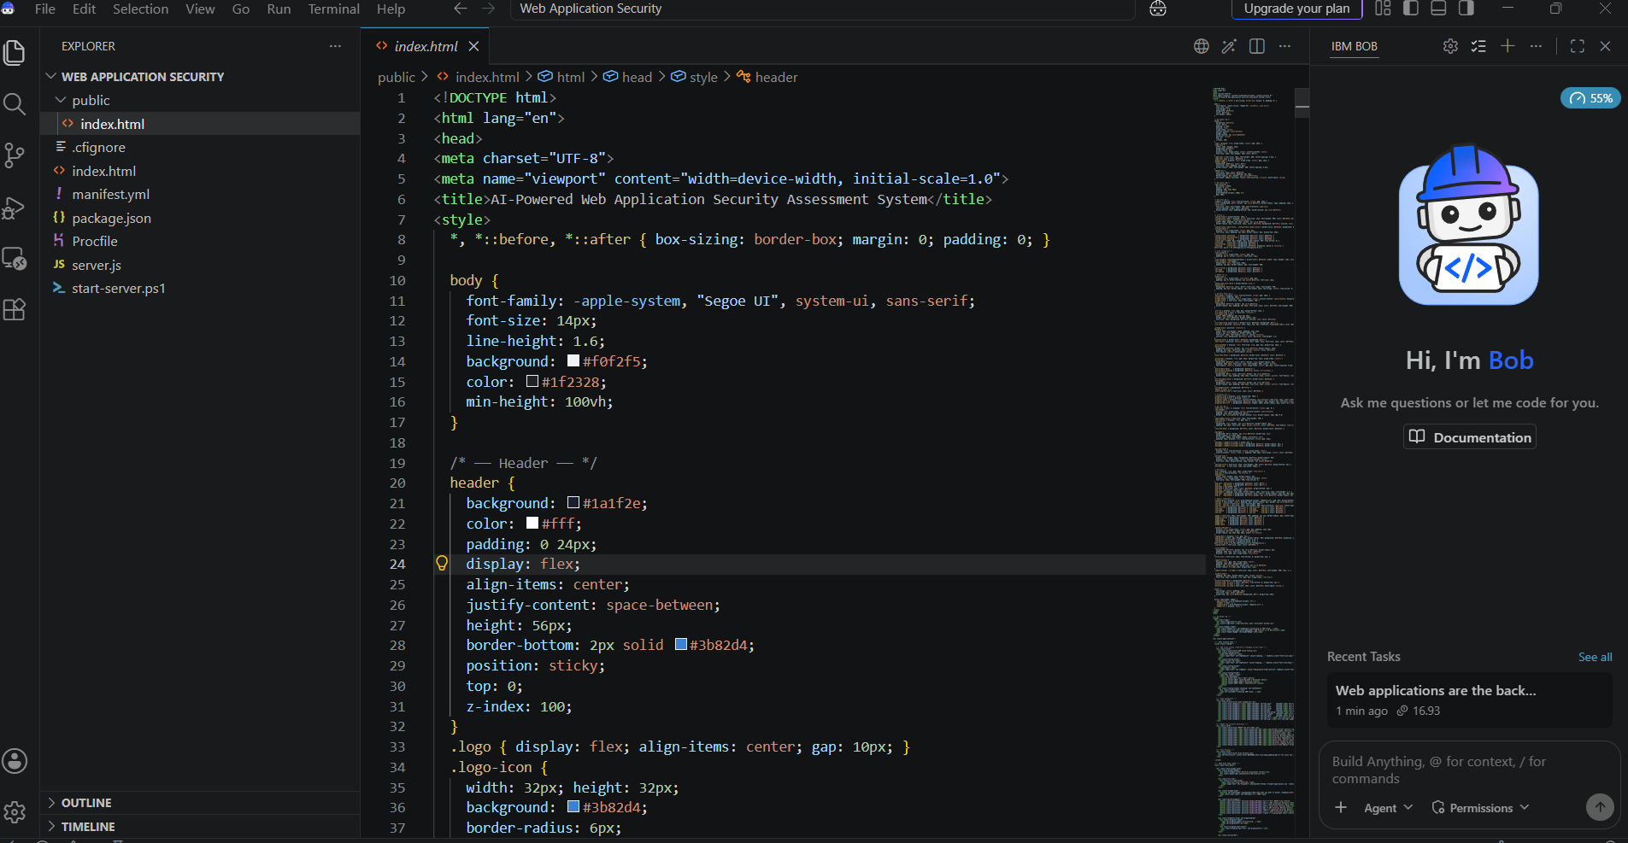
IBM Bob Screenshots:

Slide 8
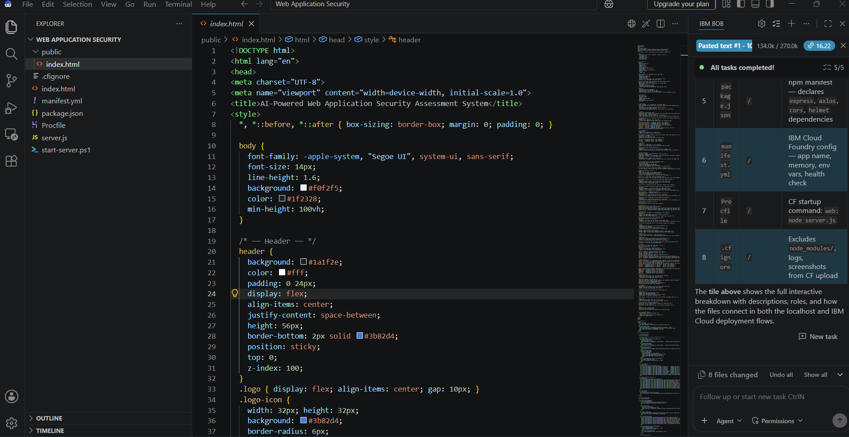
IBM Bob Screenshots:

Slide 9
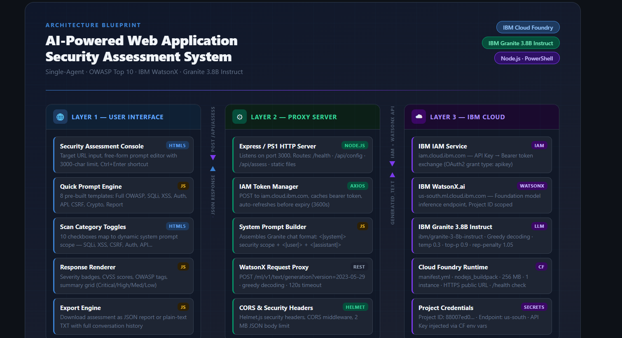
Architecture :

Slide 10

Role of Agentic AI in the solution
Role of Agentic AI in Nutrition Agent
Agentic AI enables the Nutrition Agent to function as an intelligent, autonomous system rather than a simple chatbot. Using IBM watsonx.ai and IBM Granite models, it coordinates multiple specialized agents to deliver personalized nutrition guidance.
Each agent performs a specific role—such as retrieving nutritional data, generating diet plans, providing health advice, and analyzing food logs—while working collaboratively. This multi-agent approach ensures efficient task execution and accurate results.
Agentic AI also brings context awareness, understanding user details like age, health conditions, and fitness goals to generate tailored recommendations. It supports real-time adaptation, continuously updating suggestions based on user inputs like daily meals.
Additionally, agents communicate with each other, enabling better decision-making and improved outcomes.
Overall, Agentic AI makes the system proactive, personalized, and goal-driven, acting like a smart digital nutritionist that helps users maintain a healthy lifestyle.

Slide 11
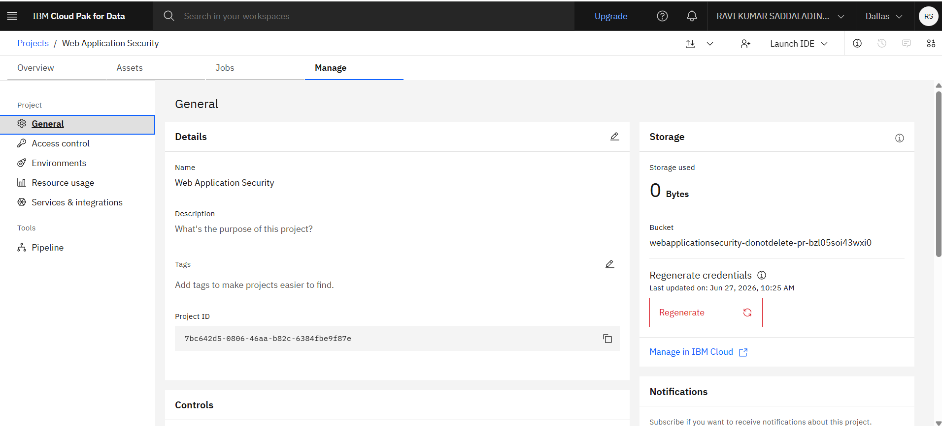
Token Usage
·
·
·

Slide 12
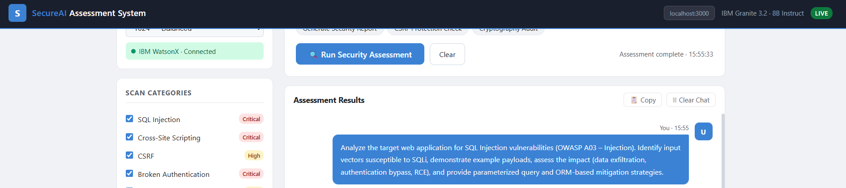
Project Input Screenshot
·
·
·

Slide 13
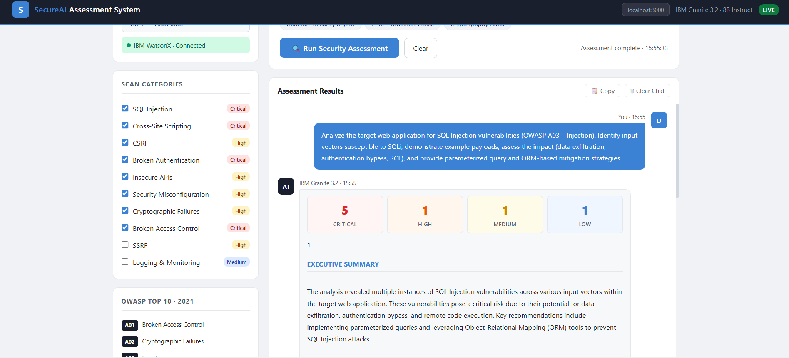
Project Output Screenshot
·
·
·

Slide 14
Novelty and Uniqueness
The proposed Nutrition Agent stands out by combining Agentic AI and personalization into a single intelligent system.
Multi-Agent Intelligence – Instead of a single chatbot, multiple specialized agents collaborate to deliver accurate and context-aware nutrition guidance.
RAG-Based Accuracy – Integrates real-time data retrieval with AI generation, reducing misinformation and ensuring trustworthy recommendations.
Hyper-Personalization – Tailors diet plans based on health conditions, cultural preferences, and fitness goals.
Real-Time Feedback Loop – Continuously adapts recommendations based on daily food logs and user behavior.
Multi-Modal Input – Supports text, voice, and image-based meal tracking for better usability.
Preventive Healthcare Focus – Goes beyond diet planning to provide disease-specific nutrition advice.
Scalable & Enterprise-Ready – Built on IBM watsonx.ai with IBM Granite models, ensuring reliability and governance.
This makes the solution a smart, adaptive, and proactive digital nutritionist, not just a static diet recommendation tool.

Slide 15
Git Hub Link
Github URL –https://github.com/drravisaddala/Web-Application-Security-Agent
·
·
·

Slide 16
Future Scope
The AI-Powered Autonomous Web Application Security Assessment Agent can be extended with advanced capabilities to improve automation, intelligence, and enterprise readiness. Some potential future enhancements include:
1. Multi-Agent AI Collaboration
Extend the system from a single AI agent to multiple specialized agents.
Separate agents can handle reconnaissance, vulnerability scanning, risk analysis, remediation, and report generation simultaneously.
2. Continuous Security Monitoring
Enable continuous monitoring of web applications instead of one-time scans.
Automatically detect newly introduced vulnerabilities and notify administrators in real time.
3. Real-Time Threat Intelligence Integration
Integrate external threat intelligence feeds.
Correlate detected vulnerabilities with the latest known threats and attack campaigns.
4. Automatic Patch Recommendations
Recommend software updates, security patches, and configuration changes based on detected vulnerabilities.
Prioritize fixes according to risk and exploitability.
5. Mobile Application Security
Extend scanning capabilities to Android and iOS applications.
Detect mobile-specific security vulnerabilities and insecure API usage.
·
·
·

Slide 17
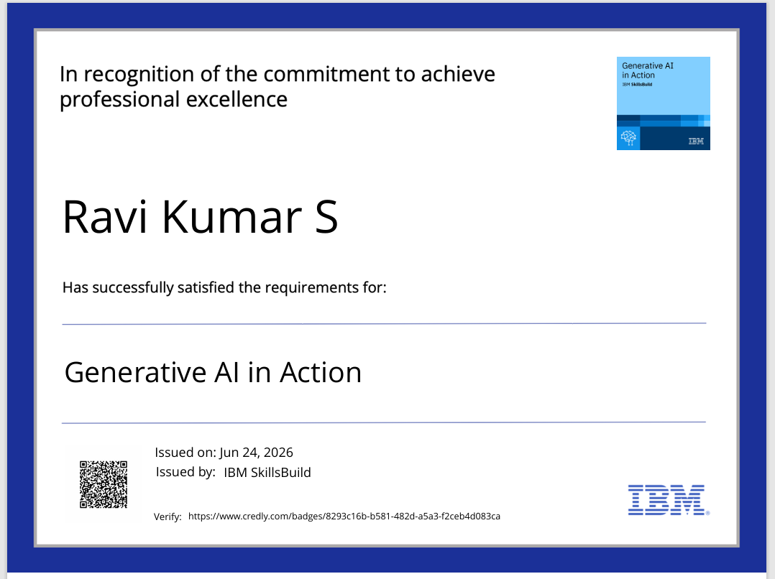
Certificates Earned:
Please add your credly certificate

Slide 18
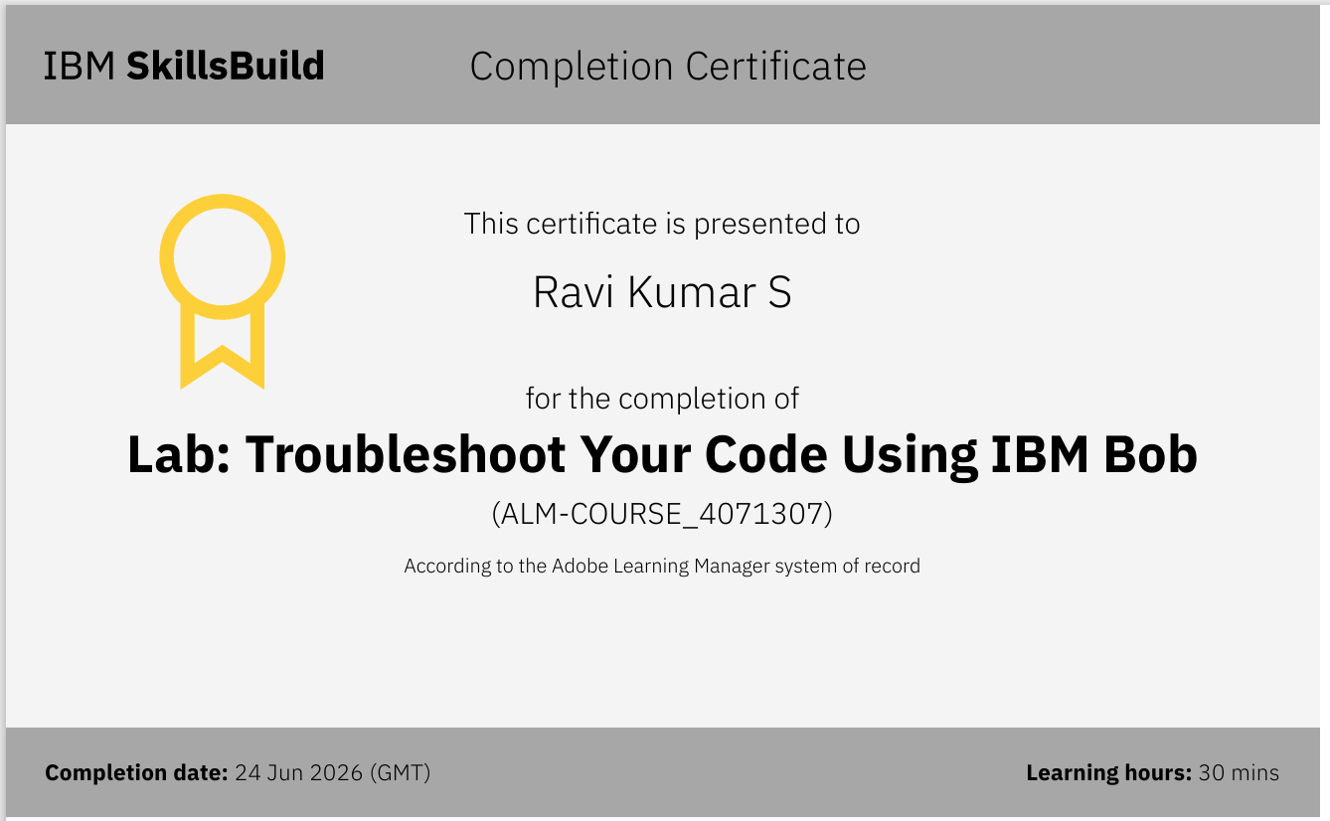
Certificates Earned:​
Add your IBM BOB Certificate

Slide 19


